Slide 1


Uncertainty in Sample Size Determination
Pilot Studies, Model Selection and Practical Equivalence.
Notes:
www.Statsols.com/trial

Slide 2

Paul Murphy
Research Statistician
nQuery

Slide 3
Agenda
Background
Model Selection
Pilot Studies
Practical Equivalence
Discussion and Conclusions
All example files will be available after the webinar

Slide 4
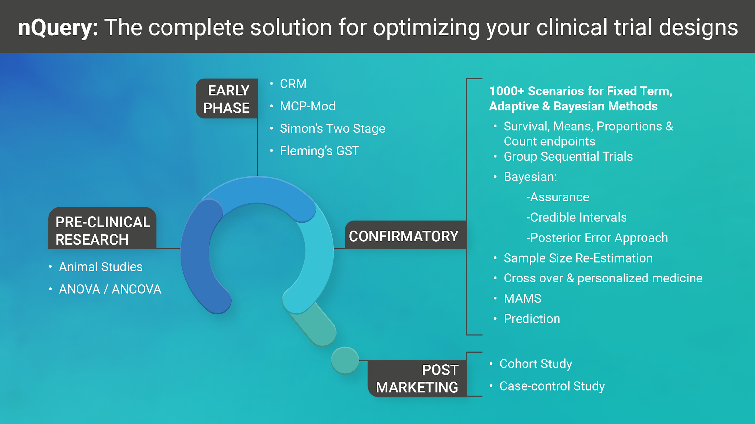

Slide 5























In 2021, 88% of organizations with clinical trials
approved by the FDA used nQuery

Slide 6
Background : Sample Size Determination
Part 1

Slide 7
Sample Size Determination
What is Sample Size Determination (SSD)?
  SSD is the process of finding an appropriate sample size for a study.
  We want to determine the minimum sample size that is expected to reach a desired value of a certain metric (e.g. power, interval width, cost).
Why is SSD Important?
  It is crucial that we arrive at valid conclusions and an appropriate sample size will reduce the chance of large errors.
  The number of subjects enrolled in a trial raises both ethical and practical considerations.

Slide 8

5 Essential Steps for Sample Size
1 |  |  | Study question, primary outcome, statistical method
2 |  |  | Significance Level, Standard deviation, ICC, dispersion
3 |  |  | Expected/targeted difference, ratio or other ES
4 |  |  | Sample Size for specified metric such as power
5 |  |  | Sensitivity Analysis, Assurance, Alternative Designs

Slide 9
Model Selection
Part 2

Slide 10
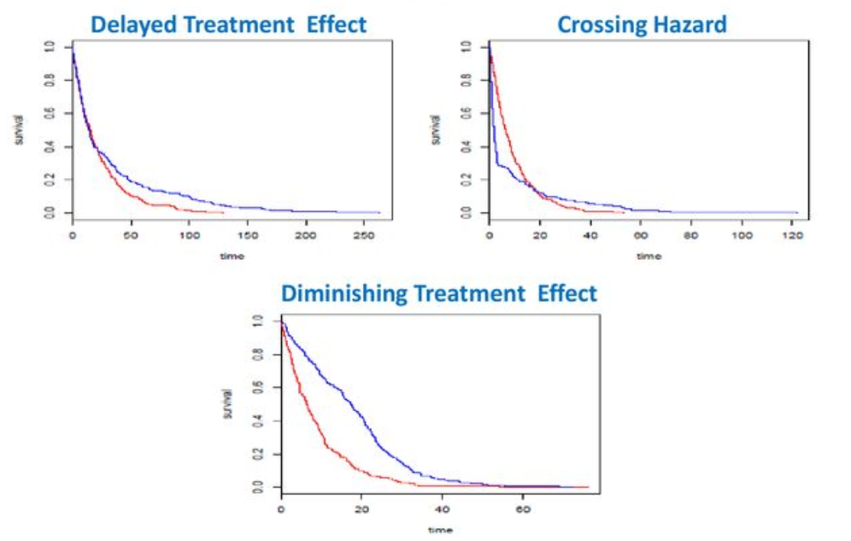
Non-Proportional Hazards
Cox PH Model (& log-rank) rely on proportional hazards assumption
  Ignoring NPH may lead to wrong inference
Non-proportional hazards (NPH) occurs where non-constant effect size (HR)
  Increase/decrease over time, crossing, stratification, delayed effect, “responders”
  Very common issue in immunotherapies
Multiple methods proposed for analysing NPH data
  Models: Weighted Linear-Rank Test, Max-Combo, Piecewise Weighted Rank Test
  Model “Free”: Median Survival, RMST, KM
Source: Satrajit Roychoudhury

Slide 11
NPH Survival Model Examples
Log-Rank Test/Cox Model | Average Hazard Ratio
Weighted Tests (Log-Rank, K-M) | e.g. Gehan, Tarone-Ware, F-H, Peto-Peto
Piecewise (Change Point) Models | Piecewise exponential, time-varying Cox
Weighted Piecewise Models | e.g. Delayed Effect Weighted Log-Rank
Combination Tests | e.g. Maximum Combination (MaxCombo)
Restricted Mean Survival Time | RMST Difference at time t*
Others | Responder-based, Frailty, Renyi tests

Slide 12
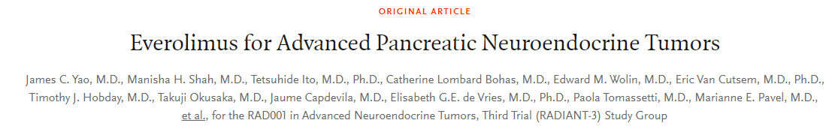
Example 1 | Non-Proportional Hazards
Using an unstratified log-rank test at the one-sided 2.5% significance level, a total of 282 events would allow 92.6% power to demonstrate a 33% risk reduction (hazard ratio for RAD/placebo of about 0.67, as calculated from an anticipated 50% increase in median PFS, from 6 months in placebo arm to 9 months in the RAD001 arm).
With a uniform accrual of approximately 23 patients per month over 74 weeks and a minimum follow up of 39 weeks, a total of 352 patients would be required to obtain 282 PFS events, assuming an exponential progression-free survival distribution with a median of 6 months in the Placebo arm and of 9 months in RAD001 arm.
With an estimated 10% lost to follow up patients, a total sample size of 392 patients should be randomized.”
Source: NEJM (2011)
Parameter | Value
Significance Level (1-sided) | 0.025
Placebo Median Survival (Months) | 6
Treatment Median Survival (Months) | 9
Hazard Ratio | 0.66667
Accrual Period (Weeks) | 74
Minimum Follow-up Period (Weeks) | 39
Power (%) | 92.6

Slide 13
Example 2 | Non-Proportional Hazards
Using the previous Everolimus example as a basis – we will explore some additional modelling challenges that would have occurred had there been non-proportional hazards:
Assume study with expected results the same as the Everolimus study but assume no effect (HR=1) for first 6 months and after that desired hazard ratio (0.666…) occurs.
We can compare effect of design if use Log-Rank (Average hazard Ratio), MaxCombo, Weighted Piecewise Linear-Rank Test and Restricted Mean Survival Time in presence of delayed effect.
Source: NEJM (2011)
Parameter | Value
Significance Level (1-sided) | 0.025
Placebo Median Survival (Months) | 6
Treatment Median Survival (Months) | 9
Accrual Period (Weeks) | 74
Minimum Follow-up Period (Weeks) | 39
Power (%) | 92.6
Delay Before Treatment Effect (Months) | 6
Hazard Ratio (Post Delay) | 0.66667

Slide 14
Pilot Studies
Part 3

Slide 15
Pilot Studies
Pilot studies are exploratory and limited in size and scope.
  Studies range from informal ad-hoc studies to large industry-sponsored trials.
  Many classes of pilot studies exist - e.g. internal vs external or designed a priori vs redefined a posteriori.
A range of questions and uncertainties and be addressed in pilot studies.
  Can be used to attain estimates for expected effect size and nuisance parameters – assessing the feasibility for a larger scale trial.
  Also useful for preliminary safety assessments and evaluating trial logistics.
The limitations of pilot studies must not be ignored
  Not designed to demonstrate efficacy to the level required for regulatory approval.
  Small sample sizes may not provide reliable estimates for nuisance parameters.

Slide 16
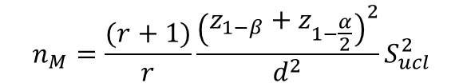
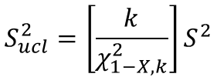


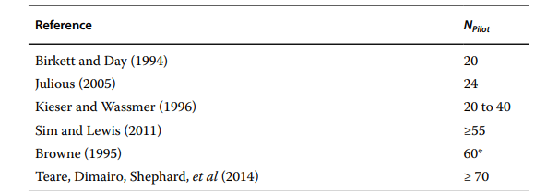
Sample Size for Pilot Studies
Upper Confidence Limit (UCL)
  Uses an upper confidence limit of pilot variance in main study.
  Common confidence limits: 80%, 90%, 95%
Non-central t (NCT)
  Accounts for the fact that we’re using a sample variance estimate.
  Tends to give lower sample sizes than UCL.
Rules of thumb
  Wide range of opinions
  Different flat and stepped rules exist.
Source: Whitehead et. al (2015)
Source: Whitehead et. al (2015)

Slide 17
Example 3 | Pilot Study
“A two‐armed parallel group (Main) randomized controlled clinical trial is being planned with a 2‐sided α=0.05 and power 1−β=0.9. The primary outcome is a continuous variable with an approximate Normal distribution. As the investigators are unsure about design aspects of the Main trial such as what the SD of the outcome measure is anticipated to be, the likely recruitment and the dropout rates, they decide to run an External‐Pilot trial. Suppose the standardized effect size to be used in the Main trial, which is the minimum that is clinically worthwhile, is Δ_{Plan}= 0.2…
….for UCL 80%, UCL 95% and NCT… ….the corresponding size of the External Pilot would be… …92, 144 and 56. The associated Main trial sizes are 1,206, 1,294 and 1,104 respectively, implying the corresponding potential Overall sample sizes of the External‐Pilot plus the Main trial of 1,298, 1,438 and 1,160 participants”
Parameter | Value
Significance Level (1-sided) | 0.05
Expected Difference | 0.2
Power (%) | 90
Pilot Standard Deviation | 1
Calculation Methods | UCL,UCL,NCT
Confidence Level for SD (%) | 80,95,N/A
Source: Sample Sizes for Clinical, Laboratory and Epidemiology Studies, Fourth Edition
John Wiley and Sons (2018)

Slide 18
Practical Equivalence
Part 4

Slide 19
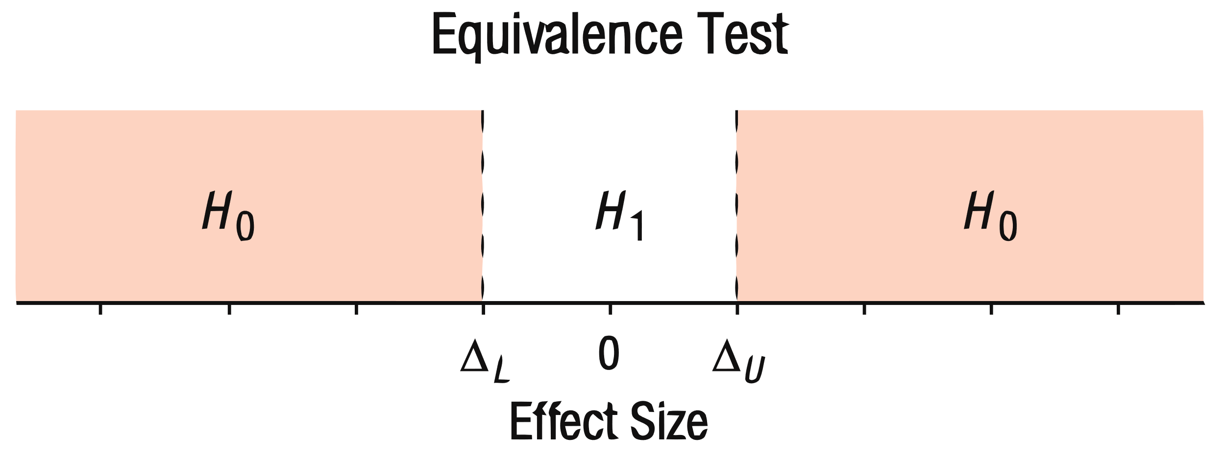
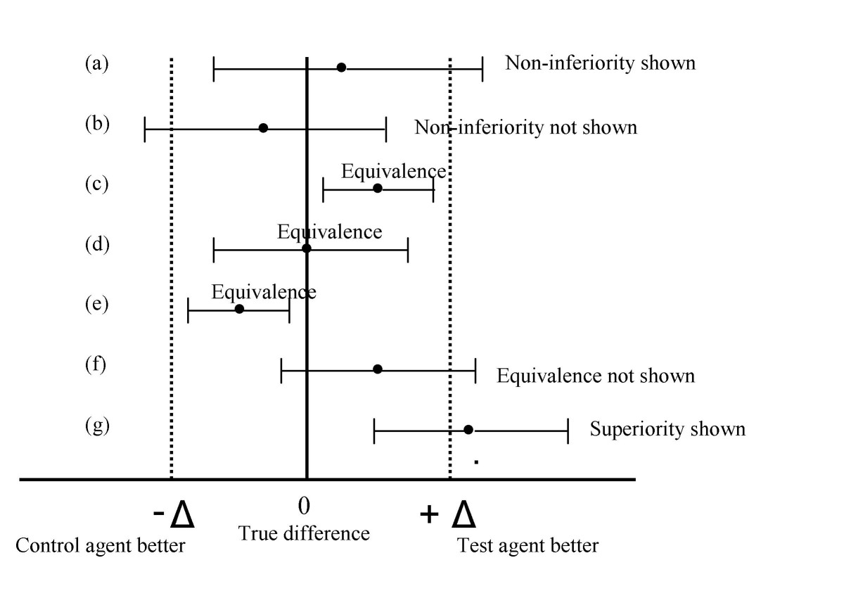
Equivalence Testing
Test if treatment equivalent to control
  Bioequivalence (Cmax, AUC) tests common
  Widely used for direct measures too
Common method is “Two One-Sided Tests”
  H0: Δ_{True}< Δ_{L} or Δ_{True} > Δ_{U}, H₁: Δ_{L}< Δ_{True} < Δ_{U}
  Test both null hypotheses at one-sided α
  NB: Type I error is equal to one-sided α
TOST ≈ Confidence Interval Method
  2 x TOST α = Confidence Level of Interval
  Confidence intervals can be unintuitive and lead to uncertainty
Source: lesslikely.com
Source: C Pater (2004)

Slide 20
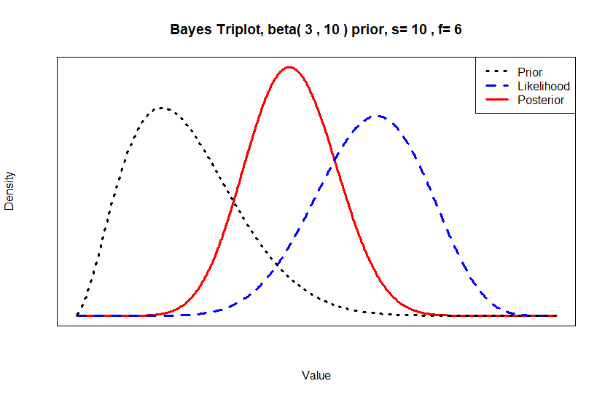
Bayesian Statistics Overview
Bayesian Statistics combines existing knowledge, expert opinion and real-world data.
Parameters to be estimated are treated as random variables.
A posterior distribution is estimated from a prior distribution and observed data using Bayesian analysis.
The posterior is used to make inferences.
Bayes’ Theorem

Slide 21
Credible Intervals
Credible Intervals are the most commonly used Bayesian method for interval estimation.
  Region of Practical Equivalence method uses credible intervals to test for equivalence
95% Credible Interval
95% Confidence Interval
Interval contains 95% of the posterior probability – i.e. there is a 95% chance that the true value is in the interval.
Unknown parameter is a RV, bounds are fixed.
Under repeated sampling, 95% of confidence intervals constructed the same way will include the true value.
Unknown parameter is fixed, bounds are RV’s.

Slide 22
Example 4 | Region of Practical Equivalence
“[A researcher] would like to conduct parameter estimation to see whether the mean IQ score of her experimental group’s population is practically equivalent to 100. She would like to know what sample size she needs to have a long-run probability of .80 of obtaining a 95% highest density interval that is contained within her predefined region of practical equivalence (ROPE). [She] hypothesizes that there is no difference (i.e., H0 is true). She considers a population effect size between -0.2 and under 0.2 to be ‘practically equivalent.’ This would correspond to IQ scores between 97 (100+15*-.2) and 103 (100+15*.2)….
…Based on these parameters, a minimal sample size of 517 per group was estimated in order to reach a 0.8 TPR for our design.”
Parameter | Value
Coverage Error | 0.05
Lower Equivalence Limit | -0.2
Upper Equivalence Limit | 0.2
Standardized Expected Difference | 0
Effect Size Location Parameter | 0
Effect Size Scale Parameter | 1/√2
Power (%) | 80
Source: Kovacs et. al (2021)

Slide 23
Discussion & Conclusions
Part 5

Slide 24
Discussion and Conclusions
Uncertainty is an intrinsic part of sample size determination. It can occur at all stages of the SSD process and can not be avoided.
Instead, we must try to better understand the sources of uncertainty and employ methods to help alleviate the issues that this causes.
In this webinar, we explored three of these methods:
  Combination tests such as MaxCombo allow us to examine the effect of model selection on the sample size of a survival study.
  Pilot studies can be used to estimate the values of nuisance parameters
  The Bayesian framework offers a more intuitive & flexible approach to equivalence testing.

Slide 25

Statsols.com/trial

Slide 26
Thank You
Contact us:
info@statsols.com
More info:
Statsols.com

Slide 27
References (Model Selection)
Yang, S and Prentice, R, 2010. Improved Logrank‐Type Tests for Survival Data Using Adaptive Weights, Biometrics 66: pp. 30‐38
Public Workshop: Oncology Clinical Trials in the Presence of Non‐Proportional Hazards, The Duke‐Margolis Center for Health Policy, Feb. 2018
Lin, R.S., Lin, J., Roychoudhury, S., Anderson, K.M., Hu, T., Huang, B., Leon, L.F., Liao, J.J., Liu, R., Luo, X. and Mukhopadhyay, P., 2020. Alternative Analysis Methods for Time to Event Endpoints Under Nonproportional Hazards: A Comparative Analysis. Statistics in Biopharmaceutical Research, 12(2), pp. 187-198.
Roychoudhury, S., Anderson, K.M., Ye, J. and Mukhopadhyay, P., 2021. Robust Design and Analysis of Clinical Trials With Nonproportional Hazards: A Straw Man Guidance From a Cross-Pharma Working Group. Statistics in Biopharmaceutical Research, pp.1-15.
Karrison, T. (2016). Versatile tests for comparing survival curves based on weighted log-rank statistics. Stata Journal, StataCorp LP, vol. 16(3), 678–690. https://doi.org/10.1177/1536867X1601600308
Tang, Y., 2021. A unified approach to power and sample size determination for log-rank tests under proportional and nonproportional hazards. Statistical Methods in Medical Research, 30(5), pp.1211-1234.
Xu, Z., Zhen, B., Park, Y., & Zhu, B., 2017. Designing therapeutic cancer vaccine trials with delayed treatment effect, Statistics in medicine, 36(4), pp. 592-605
Xu, Z., Park, Y., Zhen, B. and Zhu, B., 2018. Designing cancer immunotherapy trials with random treatment time‐lag effect. Statistics in medicine, 37(30), pp. 4589-4609.
Xu, Z., Park, Y., Liu, K. and Zhu, B., 2020. Treating non-responders: pitfalls and implications for cancer immunotherapy trial design. Journal of hematology & oncology, 13(1), pp. 1-11.

Slide 28
References (Model Selection)
Kim, D.H., Uno, H. and Wei, L.J., 2017. Restricted mean survival time as a measure to interpret clinical trial results. JAMA cardiology, 2(11), pp.1179-1180.
Royston, P. and Parmar, M.K., 2013. Restricted mean survival time: an alternative to the hazard ratio for the design and analysis of randomized trials with a time-to-event outcome. BMC medical research methodology, 13(1), pp.1-15.
Uno, H., Wittes, J., Fu, H., Solomon, S., Claggett, B., Tian, L., Cai, T., Pfeffer, M., Evans, S. and Wei, L., 2015 Alternatives to Hazard Ratios for Comparing the Efficacy or Safety of Therapies in Noninferiority Studies, Annals of Internal Medicine, 163(2), p.127
Uno, H., Claggett, B., Tian, L., Inoue, E., Gallo, P., Miyata, T., Schrag, D., Takeuchi, M., Uyama, Y., Zhao, L. and Skali, H., 2014. Moving beyond the hazard ratio in quantifying the between-group difference in survival analysis. Journal of clinical Oncology, 32(22), pp. 2380.
Eaton, A., Therneau, T. and Le-Rademacher, J., 2020. Designing clinical trials with (restricted) mean survival time endpoint: Practical considerations. Clinical Trials, 17(3), pp.285-294.
Tang, Y., 2021. Complex survival trial design by the product integration method. (Unpublished – Available on Request)
Balan, T.A. and Putter, H., 2020. A tutorial on frailty models. Statistical Methods in Medical Research, 29(11), pp.3424-3454.
Anderson, K.M., 1991. A nonproportional hazards Weibull accelerated failure time regression model. Biometrics, pp.281-288.

Slide 29
References (Pilot Studies)
Julious, S.A. and Owen, R.J. 2006. 'Sample size calculations for clinical studies allowing for uncertainty about the variance'. Pharmaceutical Statistics. Vol 5. Pages 29-37.
Whitehead, A.L., Julious, S, Cooper, C.L., Campbell, M.J. 2016. 'Estimating the sample size for a pilot randomised trial to minimise the overall trial sample size for the external pilot and main trial for a continuous outcome variable'. Stat Meth Med Res. Vol 25(3). Pages 1057-1073.
Machin, D, Campbell, M.J., Tan, S.B, Tan, S.H. 2018. 'Sample Sizes for Clinical, Laboratory and Epidemiology Studies, Fourth Edition'. John Wiley and Sons. Hoboken, New Jersey.
Loscalzo, J. (2009) Pilot Trials in Clinical Research: Of What Value Are They? Circulation, 119(13)
Leon AC, Davis LL, Kraemer HC. The role and interpretation of pilot studies in clinical research. J Psychiatr Res. 2011 May;45(5):626-9.
In J. Introduction of a pilot study. Korean J Anesthesiol. 2017 Dec;70(6):601-605. doi: 10.4097/kjae.2017.70.6.601. Epub 2017 Nov 14.

Slide 30
References (Practical Equivalence)
Kirkwood TBL. Bioequivalence testing—a need to rethink. Biometrics 1981; 37:589–591.
Berger R, Hsu J. Bioequivalence trials, intersection-union tests, and equivalence confidence sets. Statistical Science 1996; 11:283–319
O’Quigley, J. and C. Baudoin, General approaches to the problem of bioequivalence. The Statistician, 1988. 37: p. 51-58.
Westlake WJ. Symmetrical confidence intervals for bioequivalence trials. Biometrics 1976; 32:741–744
Lindley DV. Decision analysis and bioequivalence trials. Statistical Science 1998; 13:136 –141.
Schütz, H., Reference-scaled Average Bioequivalence. Bebac https://bebac.at/lectures/Moscow2016-3.pdf
Tóthfalusi L et al. Evaluation of the Bioequivalence of Highly-Variable Drugs and Drug Products. Pharm Res. 2001;18(6): 728–33.
Radicioni, M., Castiglioni, C., Giori, A., Cupone, I., Frangione, V. and Rovati, S., 2017. Bioequivalence study of a new sildenafil 100 mg orodispersible film compared to the conventional film-coated 100 mg tablet administered to healthy male volunteers. Drug Design, Development and Therapy, 11, p.1183.
Adcock, C. J. (1988). A Bayesian approach to calculating sample sizes. The statistician, 433-439
Joseph, L., Du Berger, R., & Belisle, P. (1997). Bayesian and mixed Bayesian/likelihood criteria for sample size determination. Statistics in medicine, 16(7), 769-781.
Joseph, L., & Belisle, P. (1997). Bayesian sample size determination for normal means and differences between normal means. Journal of the Royal Statistical Society: Series D (The Statistician), 46(2), 209-226.
Kovacs M, van Ravenzwaaij D, Hoekstra R, Aczel B. SampleSizePlanner: A Tool to Estimate and Justify Sample Size for Two-Group Studies. Advances in Methods and Practices in Psychological Science. 2022;5(1).
Kruschke, J. K. (2018). Rejecting or accepting parameter values in bayesian estimation. Advances in Methods and Practices in Psychological Science, 1 (2), 496 270–280.

